Slide 1

Midterm Presentation -
Click Through Rate
Vivian Kuang
Malik Aqib Rehman
Dzung Do
July 14th, 2023

Slide 2

Content
Introduction
Objective
Data
Modelling
Challenges
Conclusion
Next steps
recode … run … error … recode … run …

Slide 3

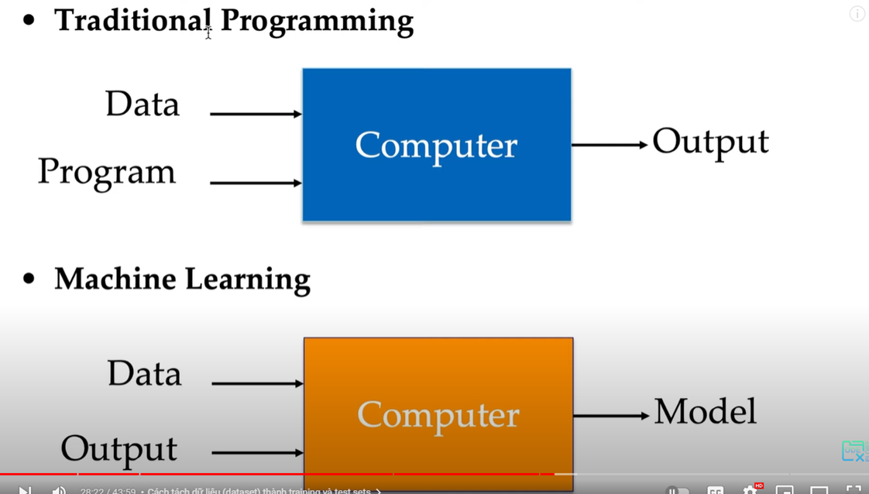
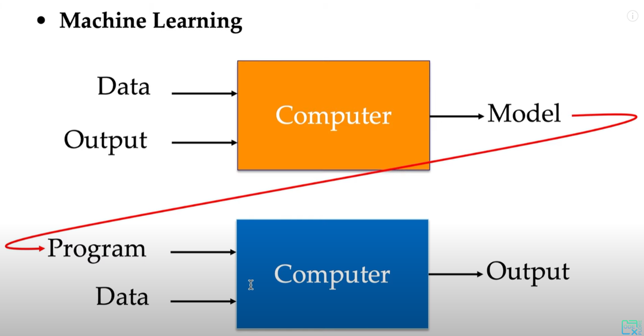
1 Introduction

Slide 4
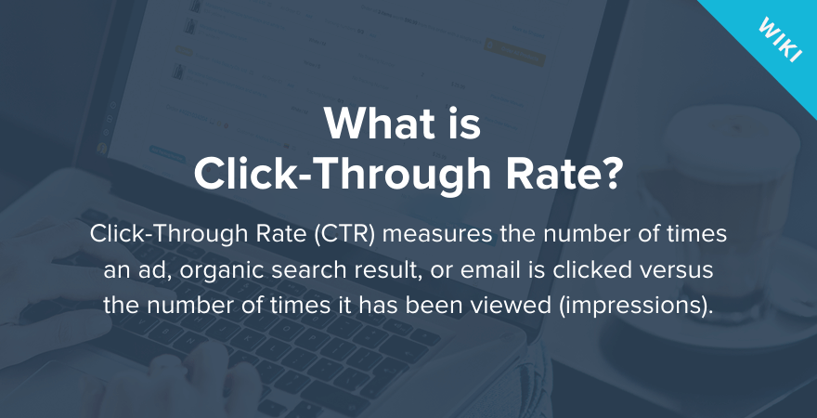
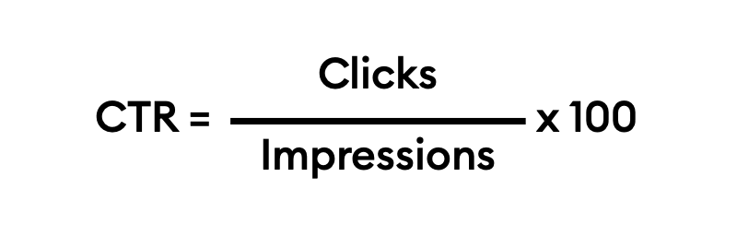
2 Objective -
clicked or not
Notes:
App -> support for payment -> users view ad. -> clicked/not
What is CTR?
Objective

Slide 5
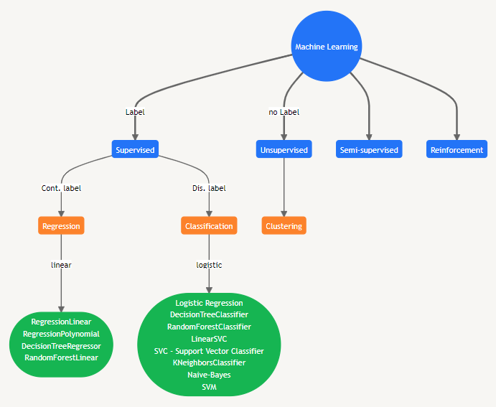
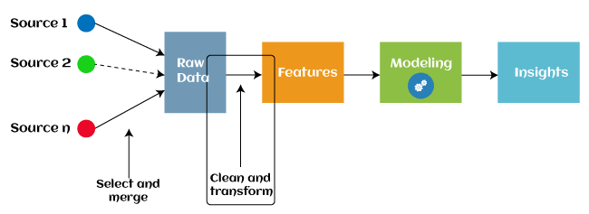
2 Objective

Slide 6
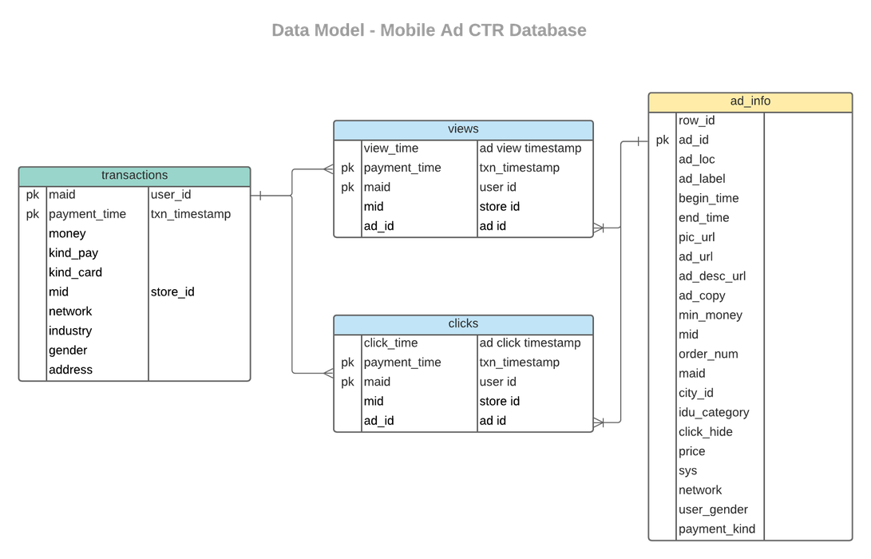
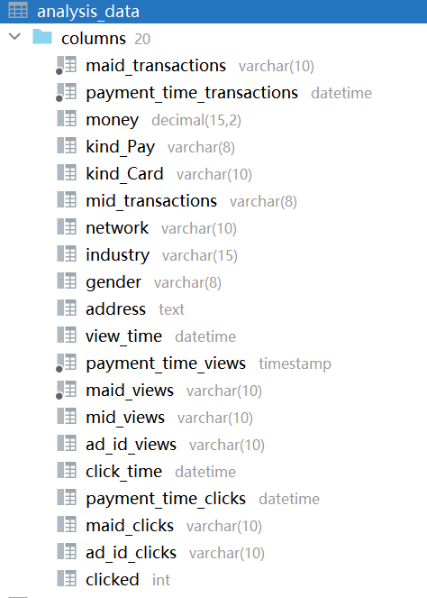
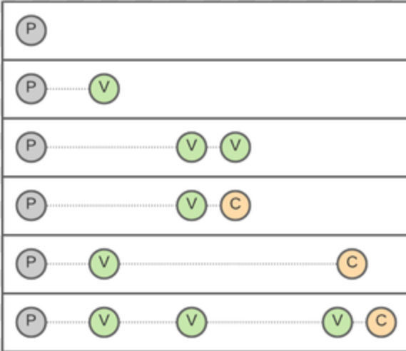
3 Data - Analyzing Data Files &
Understanding data entities
Analyze Datasets
Data Files: bulk data with imbalanced data
About 8G in total,
Tens of millions of transactions, millions of views but a couple of millions of clicks
High duplicated clicks
transactions, views, clicks, ad_info combined to => analysis_data
Final table: analysis_data
Transactions inner join on views, left join on clicks and adinfo
Scenarios for transaction-review-click relations
Notes:
Don’t have to keep all transactions, Most transactions will not lead to click, only view could lead to click, study v-c relation is more important

Slide 7
3 Data - Loading data &
Insights of the Data
Label: clicked VS Dependant Variables: more than 20 features,
No PK: load fast but need to process duplicate rows
PK: take time to process the bulk data, (split files to make it work)
Consider other choices to improve loading efficiency:
ignoring duplicates;
remove duplicates before loading
Considering business scenarios when building tables
ad_info: could be important but provides few info, View+ad_info -> clicked
Missing data: many columns are not inputted
Interesting features to study, city_id, industry, etc.
views: View-Click relation study
contain more info as it is the important step to click,
contain info such as ad_loc, ad_label, ad_info to find out the relation between view and clicked
Notes:
Without PK it take only minutes to load transactions

Slide 8
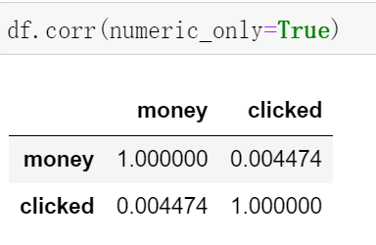
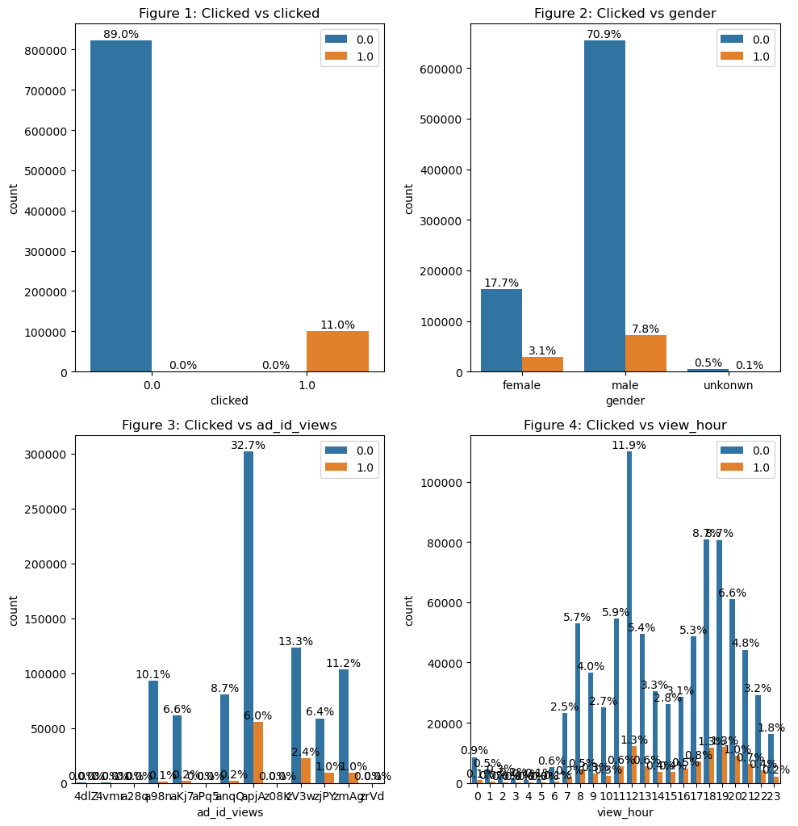
3 Data - Cleansing, Visualization and Transform
with pandas
Get some general ideas: df.head(), df.shape, df.info(), df.isnum().sum(),df.describe()
numeric features VS category features
corr(), heatmap for numeric features
.value_count, barplot to study the distribution of number of each category
Crosstab, Countplot, groupby to study the importance of category
Add features:
view_time -> view_hour
address can also be considered mapping with chinese cities and districts
Transform feature: genders, combine “” to “unknown”
Drop features: payment_time, maid, mid, etc
Features remained: ['money', 'kind_Pay', 'kind_Card', 'network', 'industry', 'gender',
'ad_id_views', 'clicked', 'view_hour']
Notes:
Without PK it take only minutes to load transactions

Slide 9
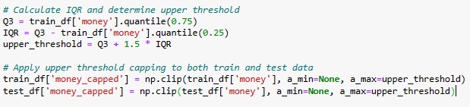
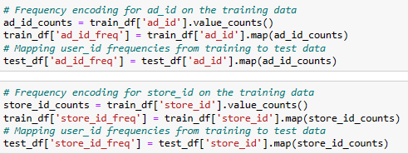
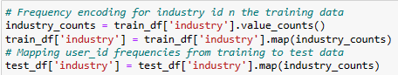
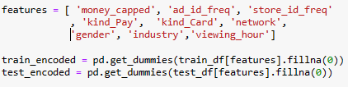
4.1 Modelling (Test/Train Split & Encoding Variables)

Slide 10
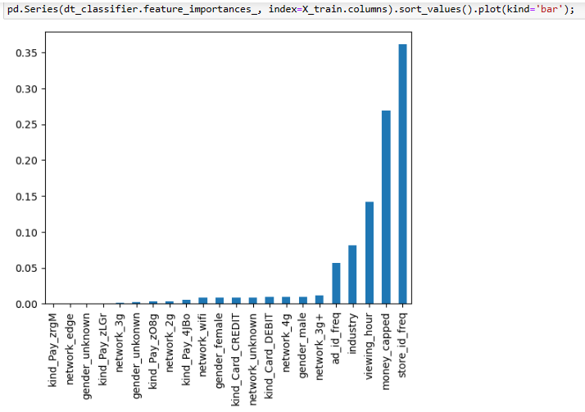
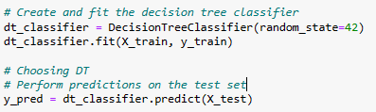
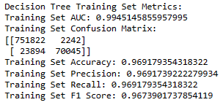
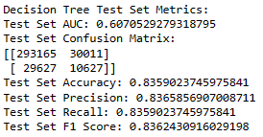
4.2 Modelling (Baseline - Decision Tree)
Separating feature matrix X_and target variable y
X_train = train_encoded
y_train = train_df['Clicked']
X_test = test_encoded
y_test = test_df['Clicked']

Slide 11
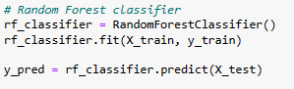
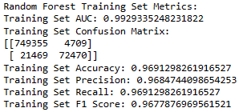
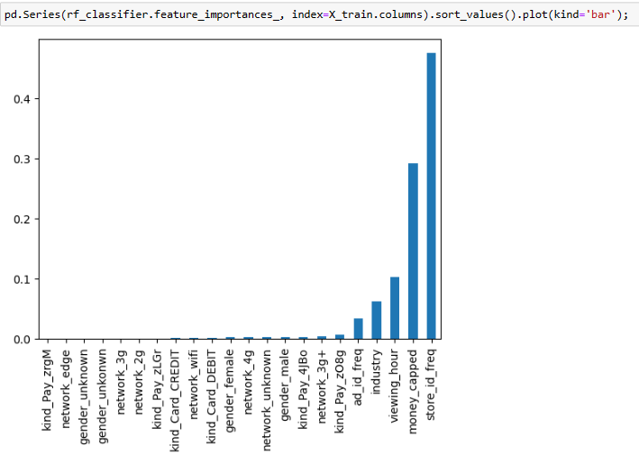
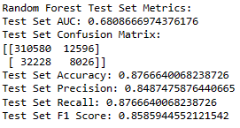
4.3 Modelling (Baseline - Random Forest)

Slide 12
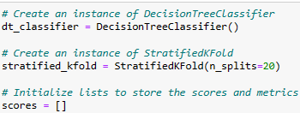
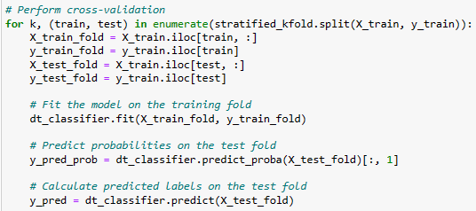
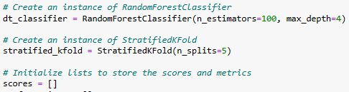
4.4 Modelling (Model Validation)

Slide 13
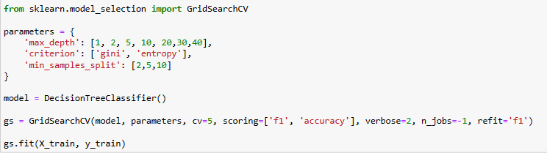
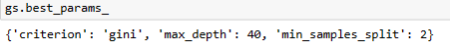
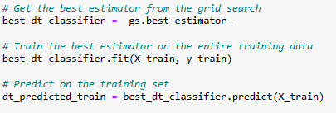
4.5 Modelling (GridSearch Hyperparameters)

Slide 14
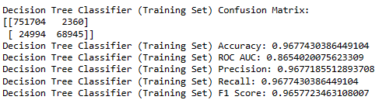
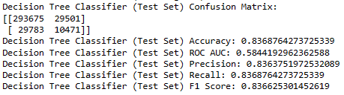
4.5+ Modelling (GridSearch Hyperparameters+)

Slide 15

5 Challenges
Many definitions, libraries, models … -> like ‘Confusion matrix’
Take long time to run the large data and transfer from sql to Python
Deal with missing values & datetime (bining)
Super imbalanced dataset (90% vs 10%)
Not get the high precision & accuracy scores
White spaces using sqlalchemy -> use regex command (as Malik case)
… to be continued …

Slide 16
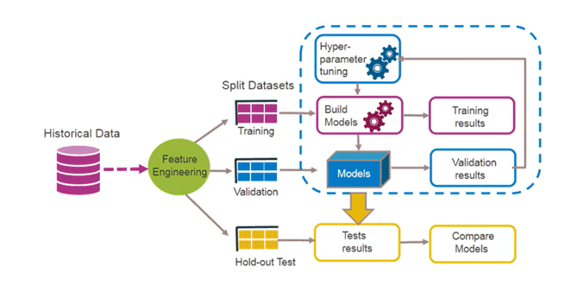

6 Conclusion
Practical assignment
Go through whole process: Raw data -> SQL -> Python -> ML
Apply , Mix & Match: SQLAlchemy, Pandas, Numpy, Libraries & Models in ScikitLearn/ imblearn
Validating how the best performing model
Hooray!

Slide 17

7 Next steps
Manage & estimate how long to make the large data over 1 million rows
Study more and apply Pipeline for filling missing values & building combinations of models
Using GridSearch for generating parameter of other models
Study more some efficient way to tune hyperparameters to get the best performing model
Thank you!
What's next?!

